Slide 1

BATTLE OF NEIGHBOURHOODS

Slide 2
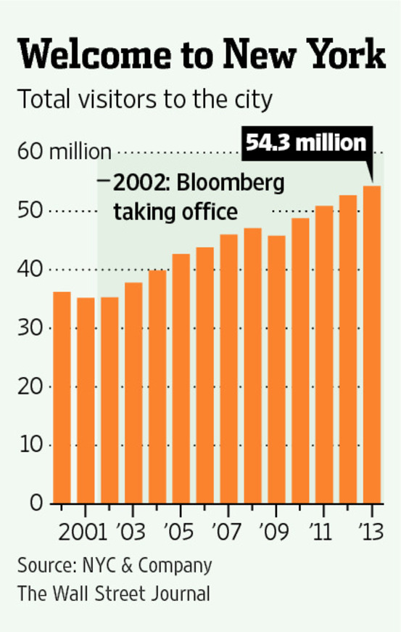
INTRODUCTION
NYC & Company has released its latest tourism figures, which found that in 2018, New York City welcomed a record 65.2 million visitors, comprising 51.6 million domestic and 13.5 million international visitors, the ninth consecutive year of tourism growth. A record 37.7 million hotel room nights were sold citywide last year, generating $623 million in estimated hotel occupancy tax revenues.
Through this project , I would like to help tourists from across the world to choose the most appropraite hotel to check-into

Slide 3
PROBLEM STATEMENT
When a tourist is trying to book a hotel room at a particular tourist destination,
then the hotels will be graded based on the following parameters
The current Ratings
The number of trending places nearby
The number of likes received
DATA SOURCE
Hotels of New York City.
Data source : Foursquare API

Slide 4
Methodology:
1. Get the list of hotels in a particular location
2. For each hotel ,calculate a grade point using the above mentioned criteria
3. Get the total number of trending places in a radius of 1000m for each hotel
4. Calculate the score for the hotel based on the above parameters.
5. Sort the hotels based on the grade and recommend to the tourist
6. For the most recommended hotel, use Folium to plot all the nearby trending venues using the information collected.

Slide 5
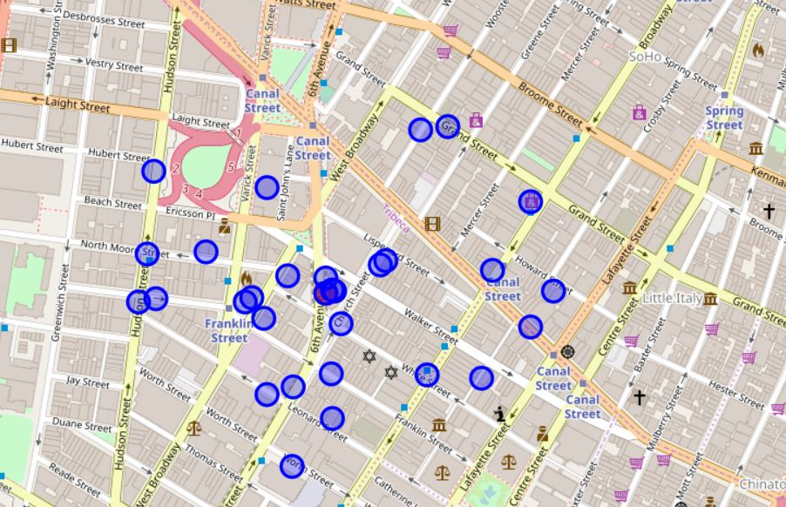
RESULTS
Roxy Hotel has topped the lists of hotels in New York City. The stats are as follows:
The number of likes : 496
Ratings :8.7
Trending places nearby :231

Slide 6
CONCLUSION
There are definitely other parameters that need to be considered before booking a hotel room such as the price, the priority of the trending place and the availability. But due to insufficient data, I have constricted my scope of parameters to the above mentioned ones.

